Slide 1
SDLC ACTIVITY
“ QUIZ GAME”
Presented by :
Ch . Maneesha (25rbaim0044)
G . Swetha ( 25rbaim0050)
K . Tanmayi sree (25rbaim0049)
Uzma begum(25rbaim0019)

Slide 2

Introduction
The Quiz Game is a simple software project designed to test user knowledge interactively.
It serves as an ideal example to demonstrate the phases of the Software Development Life Cycle (SDLC).
In the Requirement Analysis phase, rules, scoring, and question formats are defined.
The Design phase focuses on user interface layout and database structure for storing questions.
During Implementation, the game logic is coded to handle questions, answers, and scoring.
The Testing phase ensures accuracy, usability, and a smooth player experience.
Finally, Deployment and Maintenance make the game available to users and allow updates with new content.

Slide 3
Problem statement
Traditional quizzes often lack interactivity and fail to keep learners engaged. There is a need for a simple yet effective Quiz Game that makes learning fun. The game should allow users to answer questions across different topics. A scoring system must be included to track performance and motivate players. The interface should be clear, intuitive, and easy to navigate. Flexibility is required to add or update questions over time. Proper testing is essential to ensure accuracy and smooth functionality. This project demonstrates how SDLC phases can transform an idea into a working product.

Slide 4

Objective
The objective of developing the Quiz Game is to design an interactive and educational application that demonstrates the practical use of the Software Development Life Cycle (SDLC). This project aims to provide users with a simple, engaging platform where they can answer questions, receive instant feedback, and track their scores to measure performance. By applying each SDLC phase—requirement analysis, design, implementation, testing, deployment, and maintenance—the game will ensure accuracy, reliability, and user‑friendliness. It also seeks to encourage learning through play, maintain flexibility for adding new questions, and highlight the importance of systematic development practices in transforming ideas into functional software solutions.

Slide 5
Activity -1 requirement analysis
Stakeholders :
Players define usability and engagement needs.
Clients set business goals (educational, entertainment, corporate training).
Designers & Developers translate requirements into technical features.
Content Experts ensure quality and relevance of quiz material.
Testers validate requirements against expected outcomes.
Sample interview questions:
What features or elements would make the quiz game engaging and enjoyable for players?
What types of quiz questions and formats should be included (e.g., multiple choice, timed, true/false)?
On which platforms should the quiz game be available, and what performance expectations do you have?

Slide 6
Requirement
FUNCTIONAL :
NON- FUNCTIONAL
Question Management
The system must allow adding, editing, and deleting quiz
questions of different formats (MCQ, True/False, timed).
Scoring & Feedback
The game must calculate scores automatically and display
immediate feedback (correct/incorrect) after each question.
User Accounts & Progress Tracking
Players must be able to create accounts,
log in, and track their quiz history and performance.
Performance
The quiz game must load questions and process answers within 2 seconds to ensure smooth gameplay.
Compatibility
The game must run seamlessly across multiple platforms (web, mobile, desktop) with consistent user experience.
Security & Privacy
User data (scores, login credentials) must be stored securely and comply with data protection standards.

Slide 7
ACTIVITY -2 ( SYSTEM DESIGN)
Presentation Layer (Front‑End)
User Interface (UI):
  Displays quiz questions, options, scores, leaderboards.
  Provides login/registration screens
2. Application Layer (Back‑End Logic)
Game Engine / Controller:
  Manages quiz flow (question sequencing, timers, scoring).
  Handles rules (e.g., negative marking, hints).
Content Management:
  CRUD operations for quiz questions (create, read, update, delete).
Leaderboard & Analytics:
  Tracks scores, ranks, and player statistics.
3. Data Layer
Database:
  Stores user accounts, quiz questions, scores, and history.
  Example: MySQL, PostgreSQL, MongoDB.
Logs & Audit:
  Tracks user activity and system events.
  .

Slide 8
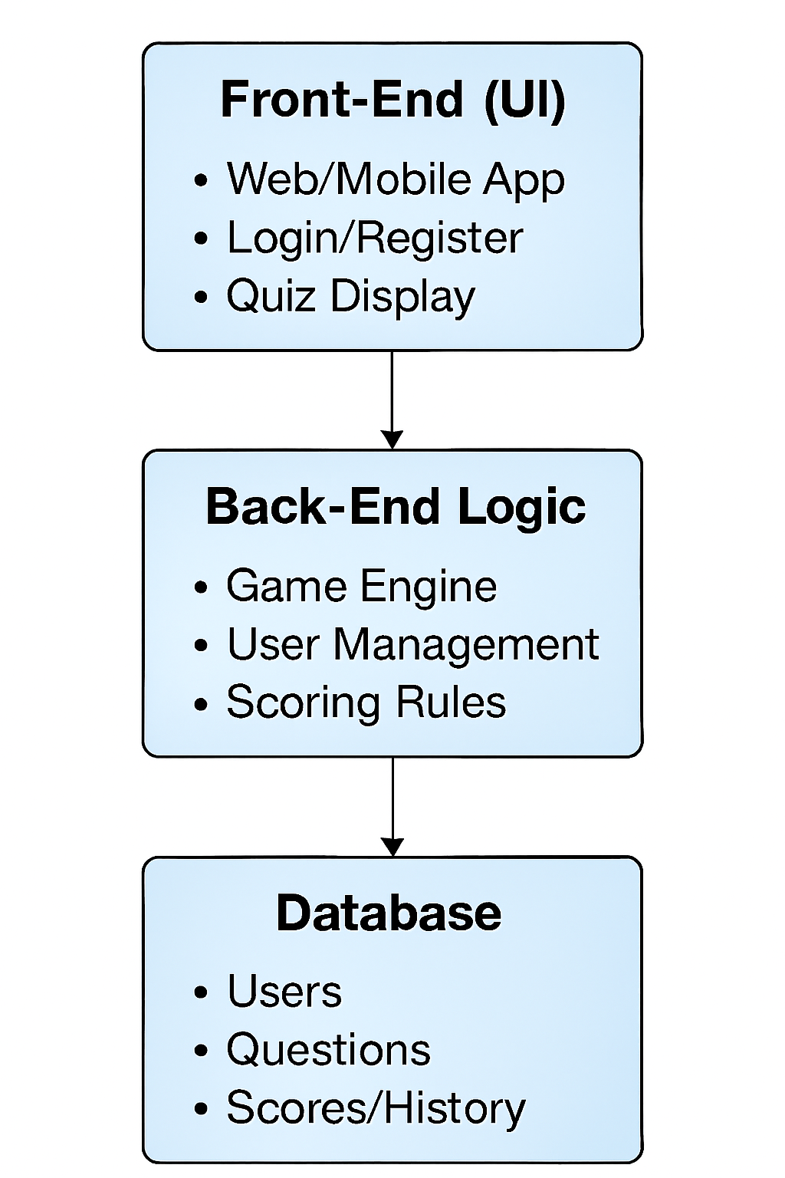
System architecture diagram

Slide 9
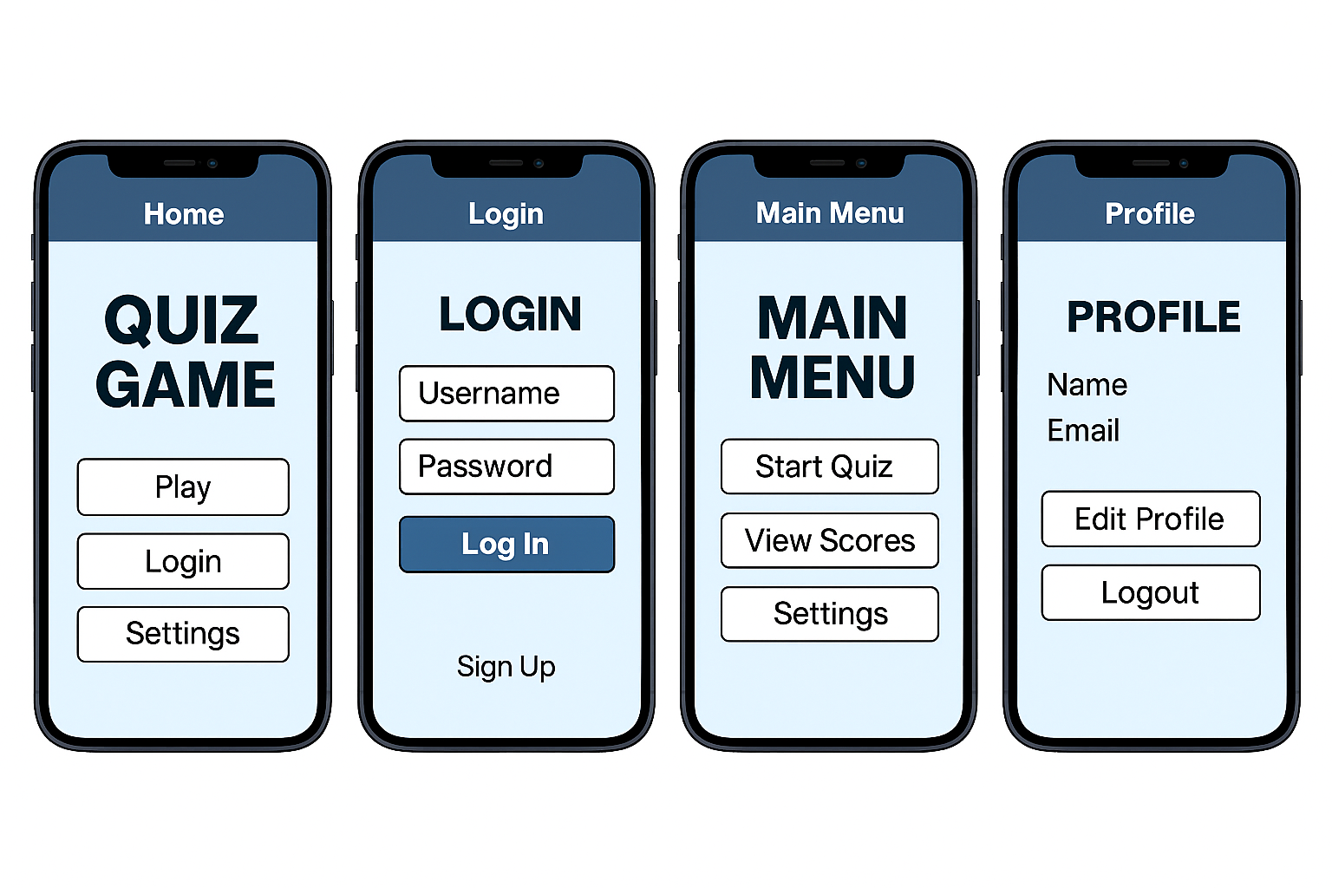
Ui wire frames

Slide 10
Database design
A well-structured database design is essential for the efficient functioning of a quiz game application. The design typically includes multiple interrelated tables to manage users, questions, answers, scores, and game sessions. The Users table stores player information such as username, email, and login credentials. The Questions table holds quiz content, including question text, category, difficulty level, and correct answer. An Answers table may be used to store multiple-choice options linked to each question. The Scores table tracks player performance, recording points earned, time taken, and quiz completion status. Additionally, a GameSessions table can log each quiz attempt, linking users to specific sets of questions and their results. This relational structure ensures data integrity, supports scalability, and enables features like leaderboards, progress tracking, and personalized quiz experiences.

Slide 11
Activity sheet -3
( development phase)
the development phase of the quiz game project, the team maintains a structured backlog to prioritize and track tasks. The backlog includes user stories, technical tasks, and bug fixes, organized by sprint and feature. For Feature 1 — the core quiz functionality — the development team focuses on implementing the question display logic, answer selection mechanism, and scoring system. This involves writing clean, modular code to fetch questions from the database, render them dynamically on the user interface, and validate user responses in real time. The code also updates the score based on correct answers and transitions smoothly between questions, ensuring a responsive and engaging gameplay experience.

Slide 12
Activity -4(testing phase)
Test id | Description | Steps | Exepected result | Actual result | Test
Tc-1 | Login functanility | Open the quiz game app. Enter valid username and password | User login success fully | User logged in correctly | Pass/fail
Tc-2 | Start quiz flow | From the home screen, select Start Quiz. The first question should load. | Quiz question score update | Question displayed score updated | Pass/fail
Tc-3 | Leaderboard update | Complete the quiz by answering all questions | Learderboard show update score and percentage | Leaderboard is updated correctly | Pass/fail

Slide 13
Activity -5(deployment and release notes)
Deployment Checklist: Before releasing the quiz game, the deployment checklist ensures all critical tasks are completed. This includes setting up servers, migrating the database, configuring APIs, applying security measures, and running final UI and performance tests. The checklist also verifies user authentication, leaderboard synchronization, and system stability under expected loads.
Known Issues: Despite successful deployment, a few issues remain. These include occasional delays in leaderboard updates, minor inconsistencies in the mobile interface, and limited offline functionality. These issues do not block core gameplay but are flagged for future improvement.

Slide 14
Features included
The deployed version of the quiz game delivers a comprehensive set of features designed to provide both functionality and engagement. Core elements include user login and registration, allowing secure account creation and personalized access. The dynamic quiz question display ensures that questions are fetched from the database in real time, supporting multiple categories and difficulty levels. A robust scoring and analytics system tracks correct answers, calculates points, and provides instant feedback to players. The leaderboard feature ranks users based on performance, encouraging competition and replayability. In addition, the settings and profile management module allows players to update personal details, adjust preferences such as sound and notifications, and review their past performance history. Beyond these essentials, the game also supports quiz categorization, enabling players to choose topics of interest, and progress tracking,

Slide 15
activity-6 (Maintance & reflection)
What Worked Well: The development and deployment of the quiz game successfully delivered a smooth user experience with core features functioning as intended. The login and registration process worked reliably, ensuring secure access for players. Quiz questions loaded dynamically from the database, and the scoring system provided instant feedback, which kept users engaged. The leaderboard feature encouraged healthy competition, while the settings and profile management allowed personalization. Overall, the system architecture proved stable, and the testing phase confirmed that most modules integrated seamlessly.

Slide 16
Path log
The path log of the quiz game project provides a comprehensive record of its evolution across all phases, highlighting milestones, challenges, and achievements. It began with the planning phase, where the team gathered requirements, defined the scope, and created initial architecture diagrams to visualize the system. This stage also involved identifying target users, selecting technology stacks, and drafting timelines to ensure clarity of direction. Moving into the development phase, the team focused on coding core features such as login and registration, dynamic quiz question display, scoring logic, and leaderboard integration. A backlog was maintained to prioritize tasks, track progress, and manage bug fixes, ensuring transparency and accountability. The testing phase followed, where unit, integration, and system testing were conducted to validate
What Needed Improvement: Despite the strong foundation, several areas require refinement. Minor delays were observed in leaderboard updates, and occasional inconsistencies appeared in the mobile interface. Offline play was limited, reducing accessibility for users without constant internet connectivity. Additionally, scalability testing revealed that performance could be optimized further when handling a large number of concurrent users. Future iterations should focus on enhancing responsiveness, improving UI consistency across devices, and expanding features such as multiplayer modes, timed challenges, and reward systems to enrich the overall gameplay experience.

Slide 17
Final reflection
The journey of developing and deploying the quiz game has been both challenging and rewarding, offering valuable lessons at every stage. From the initial planning and design to coding, testing, and deployment, the project demonstrated the importance of structured workflows, clear communication, and consistent documentation. Core features such as login, dynamic quiz display, scoring, and leaderboard integration worked well and provided a solid foundation for user engagement. At the same time, the process highlighted areas for improvement, including optimizing performance under heavy loads, refining mobile UI consistency, and expanding offline capabilities. Overall, the project not only delivered a functional and engaging application but also created opportunities for future growth, such as multiplayer modes, reward systems, and enhanced analytics.

Slide 18

Conclusion
The quiz game project successfully demonstrated the complete lifecycle of software development, from planning and coding to testing and deployment. Each phase contributed to building a functional, engaging, and scalable application that delivers core features such as secure login, dynamic quiz flow, scoring, and leaderboard tracking. While minor issues remain, the project provided valuable insights into performance optimization, UI consistency, and future enhancements like multiplayer modes and reward systems. Overall, the project achieved its objectives, created a strong foundation for continuous improvement, and highlighted the importance of teamwork, structured processes, and user‑focused design in delivering a successful product.

